Slide 2
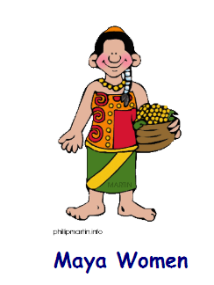
How does this compare to modern day in the UK?
Do women now have an equal role in society?
What rights do women have now in comparison to the ancient Maya.

