Slide 1
Floodlands- Marcus Sedgwick

Slide 2
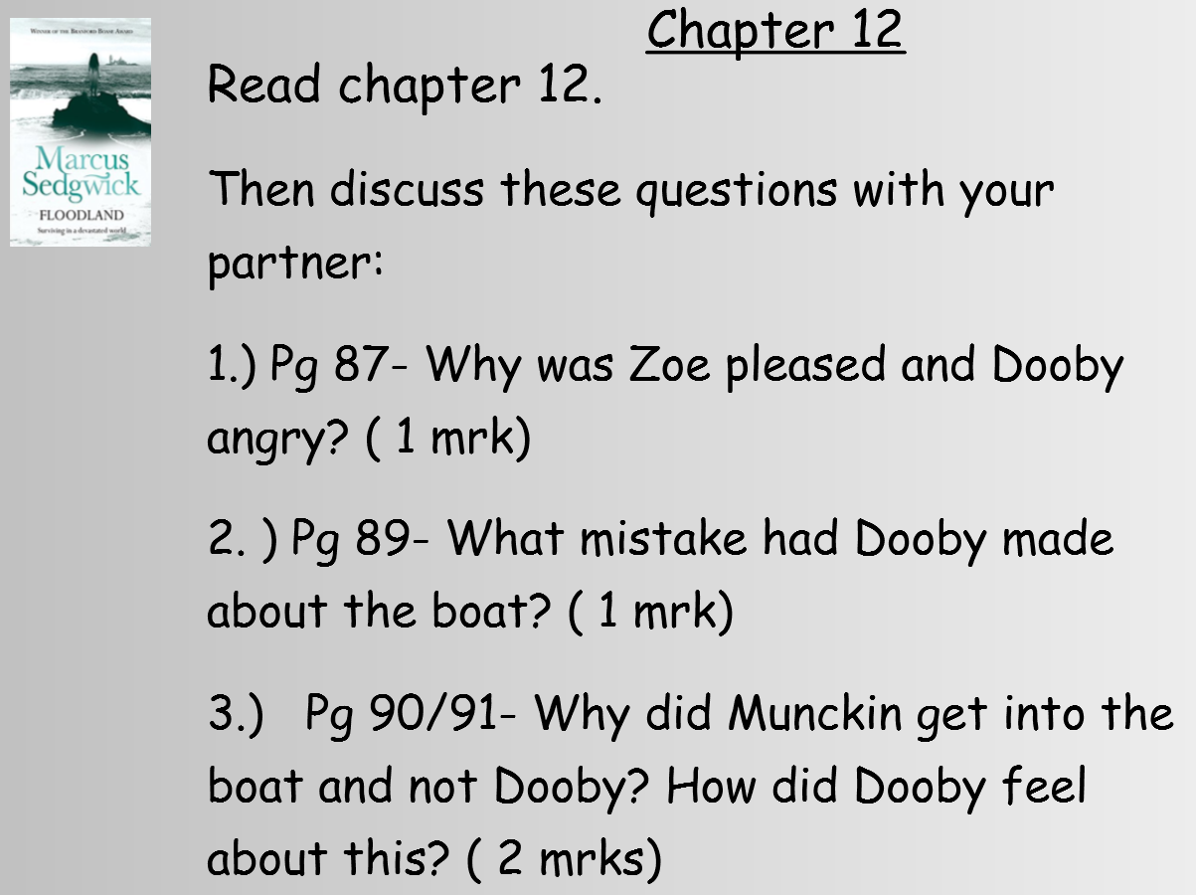

Slide 4
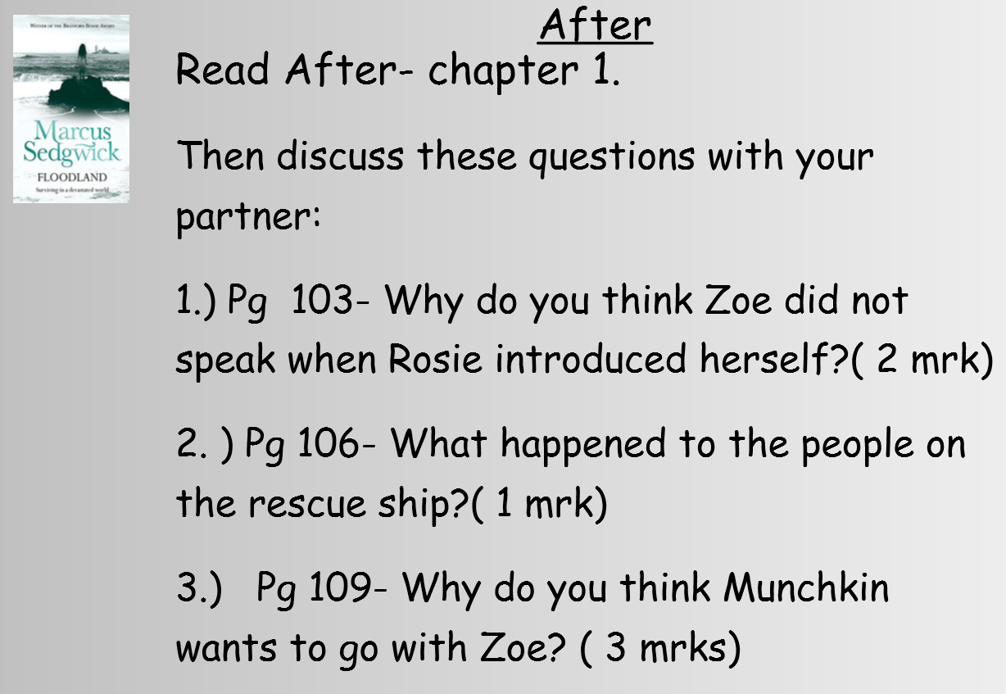

Slide 5
