Slide 1
L.O: I can identify unit and non-unit fractions
30/11/20

Slide 2
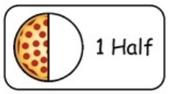
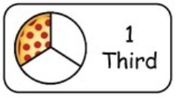
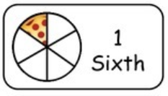
30/11/20 L.O: I can identify unit and non-unit fractions
A fraction tells us how many equal parts we have of a whole.
e.g. ½ of a pizza 1/3 of a pizza 1/6 of a pizza
The pizza is divided into 2 equal parts.
The pizza is divided into 3 equal parts.
The pizza is divided into 6 equal parts.

Slide 3
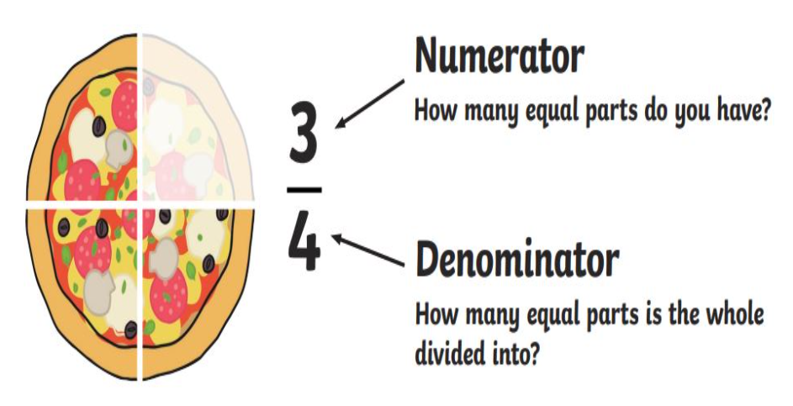
30/11/20 L.O: I can identify unit and non-unit fractions
Let’s recap our fractions vocabulary.

Slide 4
30/11/20 L.O: I can identify unit and non-unit fractions
Fractions can be either unit or non-unit fractions.
Watch the Bitesize video before continuing.

Slide 5
30/11/20 L.O: I can identify unit and non-unit fractions
So a unit fraction is one where the denominator (the number on the top!) is one. E.g:

Slide 6
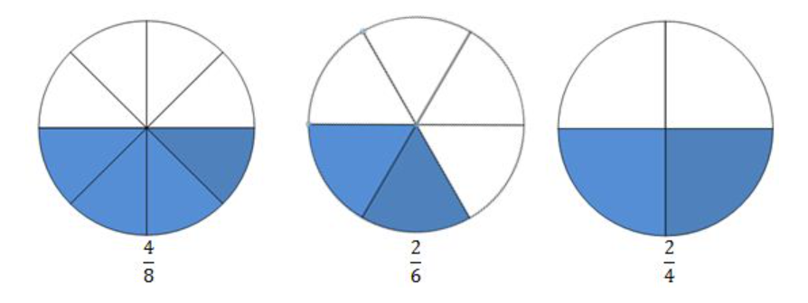
30/11/20 L.O: I can identify unit and non-unit fractions
And a non-unit fraction is one where the denominator (the number on the top!) is not one. E.g:

Slide 7
30/11/20 L.O: I can identify unit and non-unit fractions
Example 1:
What fraction of the square is red?
Remember:

Slide 8
30/11/20 L.O: I can identify unit and non-unit fractions
First, we count the number of equal parts that the shape is divided into.
It is divided into 4 equal parts so our denominator is 4.
______
4

Slide 9
30/11/20 L.O: I can identify unit and non-unit fractions
Next, we count the number of equal parts that are shaded.
There are 3 equal parts shaded so our numerator is 3.
3
4

Slide 10
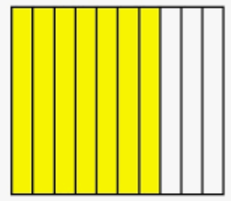
30/11/20 L.O: I can identify unit and non-unit fractions
Example 2:
What fraction of the rectangle is yellow?
Remember:

Slide 11
30/11/20 L.O: I can identify unit and non-unit fractions
Example 2:
First, we count the number of equal parts that the shape is divided into.
It is divided into 10 equal parts so our denominator is 10.
________
10

Slide 12
30/11/20 L.O: I can identify unit and non-unit fractions
Example 2:
Next, we count the number of equal parts that are shaded.
There are 7 equal parts shaded so our numerator is 7.
7
10

