Slide 1
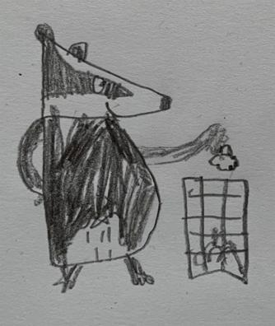
Pete

Slide 2
English - Monday 11th January

Slide 3
Choose which character from the story you would like to be.

Slide 4
Tell me about your character. Try to answer some of these questions.
What is your animal?
Where does it live?
What does it eat?
What does it do during the day?
What does it do at night?
My character is the…
Draw a picture of your character.

Slide 5
English - Tuesday 12th January

Slide 8
English - Wednesday 13th January

Slide 9
English - Thursday 14th January

Slide 10
English - Friday 15th January

